Slide 1
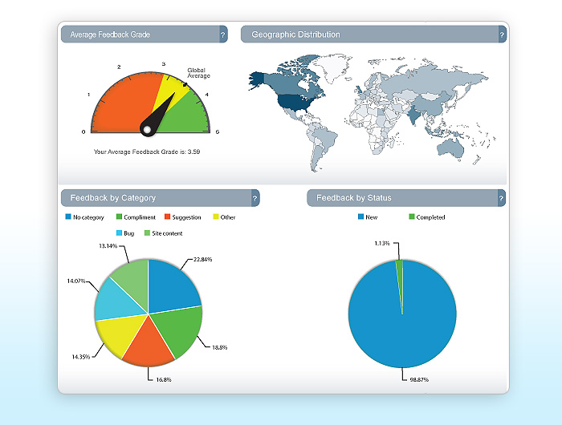

Omniture - the Adobe way Site-catalyst
“Omniture one of the most analytically flexible and comprehensive web analytics tool on the market today, makes web measurement and analysis much easier”

Slide 2

Omniture - the Adobe way Site-catalyst
Key Features Pre-built reporting – PDF, Excel, Word and HTML formats Real time segmentation Decisive Social media insight Monetize Mobile Apps Personalized Dashboard and alerts Visualize traffics, commerce and Success metrics Drill-down reports to measure complex data Optimize Video Performance Flexible Data integration Sites Using Omniture AOL Adobe Paypal Walmart Apple The Adobe® Digital Marketing Suite includes: Adobe® SiteCatalyst® – Actionable Web Analytics Adobe® Discover™ – A New Dimension in Advanced Analytics Adobe® Survey – Measure Audience Sentiment | About Omniture It is the industry-leading solution that addresses these challenges by providing digital marketers with one place to measure, analyze, and optimize integrated data from all online initiatives across multiple marketing channels. Omniture provides marketers with measurement, monitoring and insight into how social media impacts business and marketing performance. In short, its “One place to measure, analyze and optimize all of your online and multi-channel initiatives”. Benefits Know how, and what to measure to align metrics with business goals Draw actionable conclusions from interactions across growing online channels Fulfill ad hoc requests for information and business insights in a timely manner Drive enterprise adoption of standard search analytic metrics for decision makers Define online strategy based on insights gained through web site analysis from online interactions Monetize emerging channels like social and mobile Real-time segments to better understand website visitors and customers SiteCatalyst helps to improve marketing ROI Accumulate and report anonymous, aggregate, statistical information on web site usage Deliver content and advertisements optimized to client’s interests NoW You can setup OMNITURE ACROSS Verticals – Shopping, Commerce, News, Technology , Reference etc.

